Slide 1


Skill Match – Resume Matcher and Skill Recommender
Team B
Gnanendhiran V
Likitha Devarasetty
Kuruba Hemanth Kishore
Lokeshwari Cheeraboyina
Chunduru Manasa
Krishna Sree
Notes:
1

Slide 2

Introduction: Bridging the Skill Gap
Our project, "Skill Match," is designed to revolutionize how job seekers and employers connect. It's a smart system that analyzes resumes against job descriptions, providing a comprehensive match score and identifying crucial skill gaps.
This tool helps users understand their strengths, pinpoint areas for improvement, and receive tailored recommendations to enhance their job readiness.
Notes:
2

Slide 3

The Challenge: Navigating the Job Market
Resume-Job Fit Confusion
Students often struggle to understand how well their resume aligns with specific job requirements.
Time-Consuming Manual Reviews
Recruiters spend excessive time manually reviewing countless resumes, leading to inefficiencies.
Unclear Skill Gaps
Applicants lack clear insights into their missing skills, hindering targeted self-improvement.
Lack of Quick Analysis
There's no readily available tool to quickly highlight both matched and missing skills.
Notes:
3

Slide 4





Our Objectives: Empowering Job Seekers
Extract Skills
Compare & Score
Identify Gaps
Automatically identify and extract relevant skills from resumes and job descriptions.
Compare extracted skills to compute a precise resume-job match score.
Clearly highlight missing skills required for the job and extra skills possessed by the applicant.
Recommend Skills
Provide Clear Insights
Provide actionable recommendations for skills to acquire, improving job readiness.
Present comprehensive and easy-to-understand results to users.
Notes:
4

Slide 5






End-to-End Project Workflow
Inputs
Preprocess
Parse
Normalize
Match & Results
Our system streamlines the entire process, from input to insightful output, ensuring a comprehensive analysis for every user.
Notes:
5

Slide 6

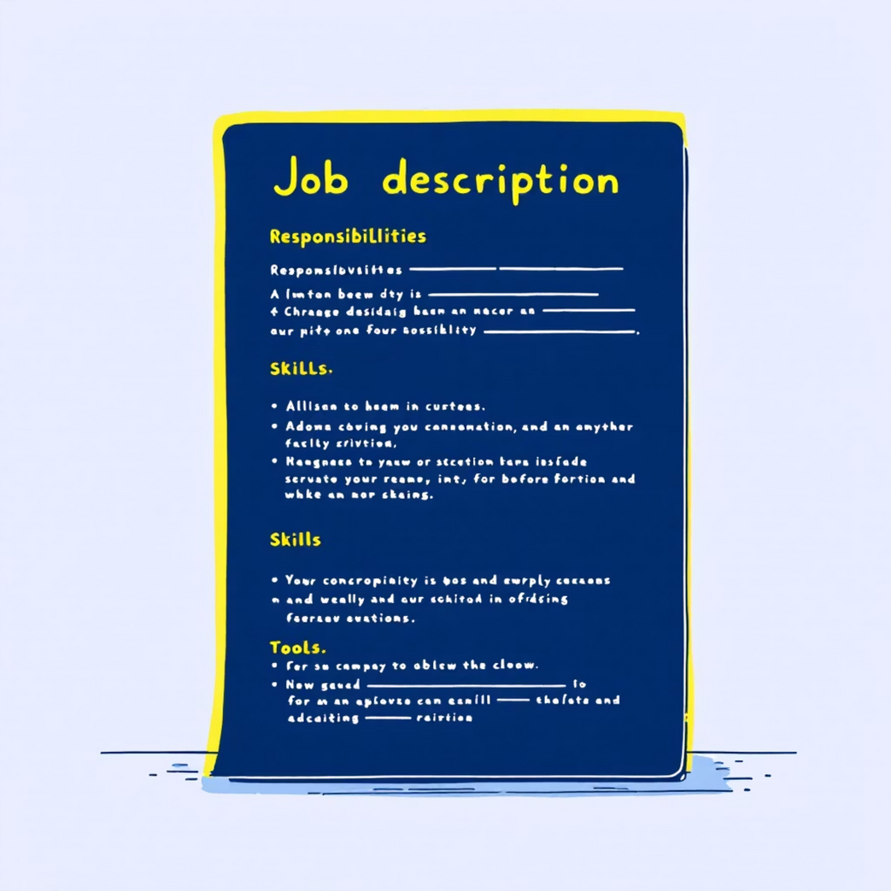
Data Processing: Resume & Job Description Parsing
Resume Parsing
Job Description Parsing
We meticulously extract key sections from resumes, including personal information, education, work experience, projects, certifications, and skills. The system also filters out noise to convert raw text into a structured, analyzable format.
Similarly, our system dissects job descriptions to identify essential elements such as required skills, responsibilities, specific tools or technologies, and experience expectations. This ensures a precise understanding of employer needs.
Notes:
6

Slide 7
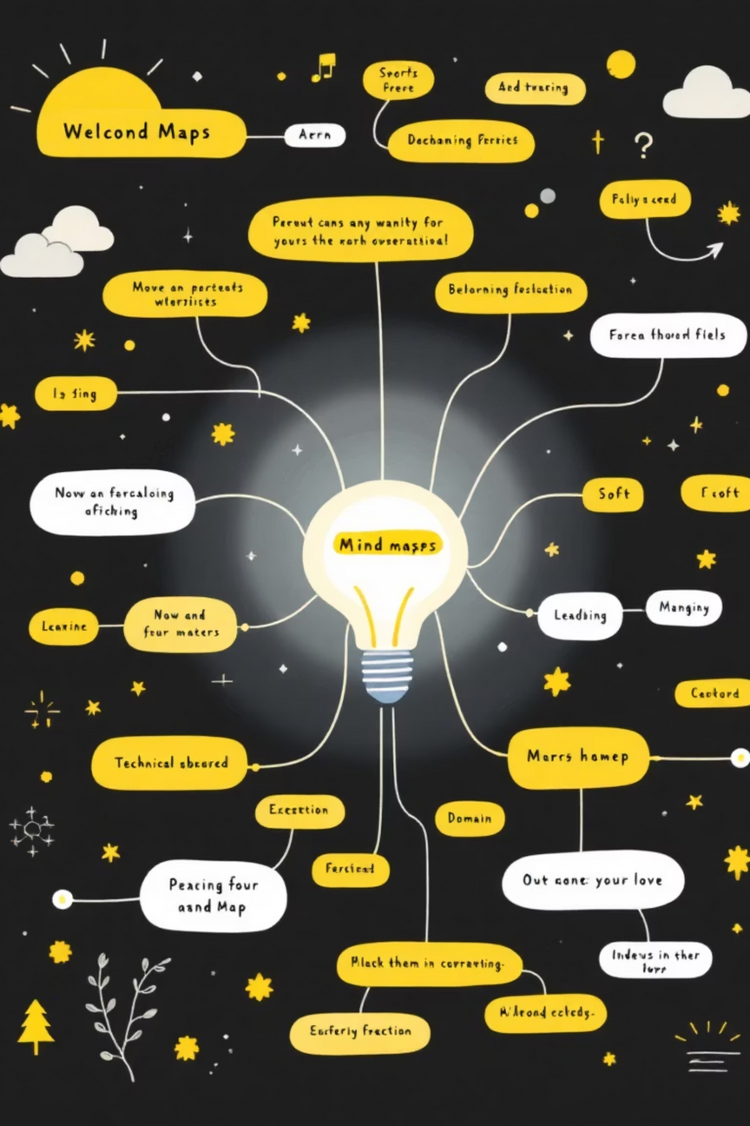
Skill Extraction and Categorization
Identify All Skill Types
1
Extract technical, non-technical (soft skills), domain-specific, and general skills.
Normalize Skills
2
Handle variations and duplicates (e.g., "JS", "JavaScript", "Node.js") to create a consistent skill list.
Categorize for Analysis
3
Group skills into categories for more granular and insightful analysis, improving relevance.
Notes:
7

Slide 8

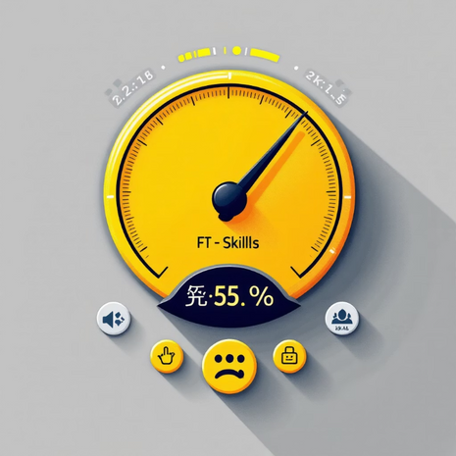
Skill Matching & Score Calculation
The Matching Process
Match Score Calculation
Our core logic compares the skills extracted from the resume against those from the job description. This comparison yields three distinct categories:
Matched Skills: Skills present in both the resume and job description.
Missing Skills: Skills required by the job but absent from the resume.
Additional Skills: Skills present in the resume but not explicitly mentioned in the job description.
A precise percentage score is calculated, indicating the degree of alignment. This score is derived from:
Skill overlap
Relevance of matched skills
Completeness of required skills
Notes:
8

Slide 9

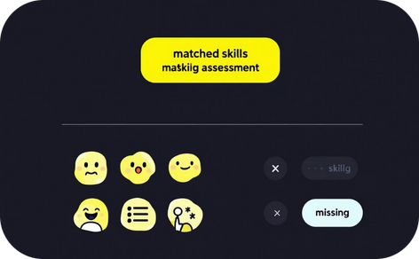
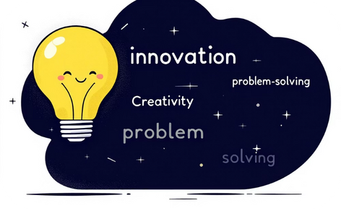

Dynamic Output Presentation
Match Score at a Glance
Skill Breakdown
Tailored Recommendations
Improvement Roadmap
Detailed lists of matched, missing, and additional skills.
A clear percentage showing overall compatibility.
Actionable suggestions for skill acquisition.
Guidance on how to enhance your resume and skill set.
The results are presented in an intuitive dashboard format, providing users with immediate and actionable insights.
Notes:
9

Slide 10
Thank You !
Notes:
10

